Slide 1
Why GitHub?
GitHub is
not just a software version control systems, but also a new communication platform for everybody
and I am so interested in GitHub because
Strong Product with Strong Developer Engagement - Competitive market share, huge awareness in consumer segments
Product Driven Culture - Fun for Marketing People!
Deeply impressed by corporate philosophy/vision:
“Our job is to build the future of software together with people who don’t even know they belong in it yet” (Nicole Sanchez)

Slide 2
Why OSS?
OSS is
Key Driver to grow and evolve company’s eco-system, which allow organization to become more flexible, capable of quickly responding to new challenges and capitalizing on new opportunities
and I am so interested in OSS because
OSS can be a viral marketing channel - When developers open-source their components and applications they also bring new developers to you, the whole process becomes self-sustainable, viral, and turns into a marketing avalanche

Slide 3
GitHub Japan
Marketing Strategy

Slide 4
Value Proposition: GitHub Enterprise
To the (role) | in-house Developers in internet based companies or companies based on software
Who wants to (buyer aspiration based on capabilities in this dimension of proficiency and current buying behavior) | share source code with extremely high performance system, also wants to feel “The human side of software” in their product development process (= social coding) when working on a team
GitHub is the only partner that can (differentiated benefits) | provide extremely high performance “virtual appliance” system with very low administrative overhead
through our (lead-with offering) | GitHub Enterprise
because (proof points) | GitHub is trusted by more than 100,000 organizations worldwide including Japan top leading internet based companies such as GREE, Yahoo! JAPAN, DeNA, Cookpad, LINE and CyberAgent

Slide 5
Persona
in-house Developers in larger companies:
Who is involved in the innovation, design, coding, testing and maintenance for both front-end and back-end development depending on the needs and resources of a project.
He mainly codes in C# or Java for customer-facing applications. He also uses HTML/CSS, JavaScript, and some PHP for smaller web or mobile projects. He also integrates with back-end web-services, APIs, legacy applications, databases and packaged applications.
He wants to get work done quickly and with minimal interruptions. He wants tools that allow more effective collaboration and communication.
Client Challenges
Deal with delays and bottlenecks across the software delivery lifecycle, achieve faster response times for defect analysis and remediation.
Communicate effectively with clients and co-workers; working remotely with colleagues.
Work with multiple tools across multiple projects.
Keep things in-sync across multiple projects.

Slide 6
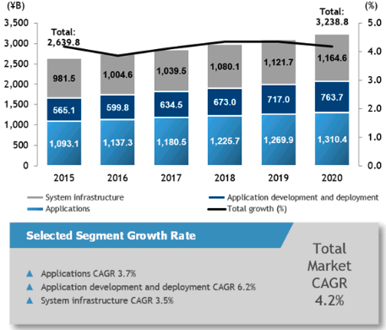
Japan Market Assessment Highlights (1/2) Market Condition Highlights :
Japan Software Market Revenue Snapshot
2015-2020 Revenue (¥B) with Growth (%)
Market Trend
Overall: Japan software market revenue will grow 3.9% year over year (YoY) in 2016 to reach 2.74169 trillion yen and will continue to grow from 2015 to 2020 at a compound annual growth rate (CAGR) of 4.2%.
Application development and deployment market: CAGR from 2015 to 2020 will be 6.2%.This market will grow 6.1% YoY in 2016. Market is driven by high growth in data access, analysis, and delivery software market with growing demand for Big Data and analytics, as well as in application platform market that includes the increasing utilized platform as a service (PaaS).
Quality and life-cycle tools market: CAGR from 2015 to 2020 will be 4.5%.Systems integrators recognize process improvement aimed at improving project productivity as a business issue, and response to applications development will be required more than ever. DevOps that unifies development and operation will grow more important because of increased mobile applications development and penetration of cloud services utilization.
Source: IDC Japan, December 2016

Slide 7
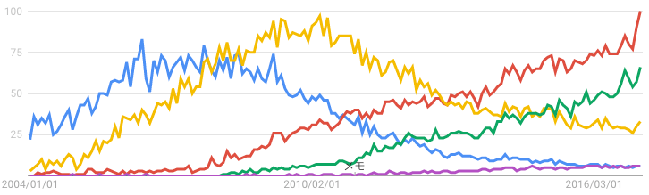
Japan Market Assessment Highlights (2/2) Competitive Landscape Highlights :
Google Trends snapshot: Version Control Hosting solutions
GitHub
1,400 + customers on the B2B side, and close to 300,000 users on GitHub.com in general.
GitHub already had a brand awareness and user base in consumer segment from the very beginning, but need more awareness on the B2B side to expand the business.
Competitors
Two different levels of competitors in the market. One is legacy competition, centralized version control systems such as subversion (SVN).The other is direct competition, companies like Atlassian and GitLab.
Legacy competition with subversion (SVN) shows a fierce battle. Subversion still get a strong presence in Enterprise segment.
Price is still a critical factor in selection of version control systems package, and subversion and GitLab take advantage for it.
■Git ■GitHub ■SVN ■subversion ■BitBucket
2013/1
# Google keyword search
category | keyword | # search results
Legacy Competition | “GitHub” + “使ってみた” | 785,000
 | “Git” + “使ってみた” | 563,000
 | “SVN” + “使ってみた” | 209,000
 | “subversion” + “使ってみた” | 208,000
Direct Competition | “GitHub Enterprise” + “使ってみた” | 92,000
 | “GitLab” + “使ってみた” | 66,500
 | “BitBucket” + “使ってみた” | 58,400
Notes:
https://www.g2crowd.com/categories/version-control-hosting

Slide 8
Executive Summary: Go to Market Strategy
WIP
Offerings / Target Category/ KPI
Target Segment Planning #2
Message / Distribution Model by Segment
Lead with Offering
GitHub Enterprise
Target Client Category
Internet based Companies, companies based on software regardless of industries
Demand and Concern
Fast deployment, multiple project management, better communication among team
Target Audience
in-house Developers in Enterprises
Expected Outcome/KPIs
ACV, # user growth
Segment | Priority | Message | Delivery Channel
(A) | High | GitHub Enterprise can provide secure and extremely high performance “virtual appliance” system with very low administrative overhead | Business Partners Direct Sales
(B) | Mid ? | GithHub can put product code in one place and all of systems are on their own infrastructure | Online Business Partners
(C) | Low ? | GitHub Enterprise can provide secure and extremely high performance “virtual appliance” system with very low administrative overhead | Direct Sales Business Partners
1
3
Target Segment Planning
2
4
Dependency/Blockers
 |  | Industry
 |  | Internet | Financial Service?
Company Rev. size | > $5B US | # Accounts: 3 (SB,Yahoo! Japan,Rakuten) | # Accounts: 47
 | $1B US-> $5B-US | # Accounts: 30 (A) | # Accounts: 107 (C)
 | Under $1B US | # Accounts: WIP (B) | # Accounts: WIP
 | Item
1 | Business Partner enablement
2 | salesforce resources
3 | Content localization: things like documentation, collateral support and owned web
4 | Marketing budget/resources
Large Enterprise
Medium Enterprise
SME
Notes:
https://www.statista.com/statistics/264621/market-value-of-the-top-20-internet-companies-in-japan/

Slide 9
FY17-18 Timeline
WIP
 |  | Q1 | Q2 |  |  | Q3 |  |  | Q4 |  |  | 2018 Q1
 |  | Apr | May | Jun | Jul | Aug | Sep | Oct | Nov | Dec | Jan | Feb | Mar | Apr
Signature Event |  |  | GitHub Satellite 2017 London May 22-23 |  |  |  |  | GitHub Universe 2017 October 10-12 |  |  |  |  |  | GitHub Constellation Tokyo 2017
PR/AR
Event / Seminar | Private
 | 3rd Party
E2E Digital
Always-on Digital
Collateral
★ GitHub Constellation Tokyo(June6)
★ GitHub Constellation Tokyo 2017 Sponsorship sales start
★ GitHub Constellation Tokyo 2017 Save the Date Start
★ GitHub Constellation Tokyo 2017 Registration Open
★ GitHub Constellation Tokyo 2017 Sponsorship tapping start
★ GitHub Universe 2017 Japan Tour(Client & Media)
★ New Product Launch/Partnership announcement
★ Patchwork Tokyo(May1)
★ GitHub Enterprise Seminar/w IBM
★ GitHub Enterprise Seminar/w IBM
★ GitHub Enterprise web seminar series(Live and On-Demand)
★ DevOps Days Tokyo 2017(Apr25)
★ Yahoo! JAPAN Tech Conference 2018
★ AWS Dev Day Tokyo 2017 (May31-Jun2)
★ MS de:code 2017 (May23-24)
★ Developers Summit 2018
★ special feature article on WIRED Japan
★ Paid Search (e.g.: DevOps, Social Coding)
★ Customer Stories
★ Customer Stories
★ Customer Stories
Notes:
Local Medias
TechCrunch Japan
Publickey
@IT
Toyokeizai.net

Slide 10
2017Q3 Japan Marketing Budgeting
2017 Cloud Ad Spending Plan
Category Details | 3Q Budget ($K) | Portion
SEM, MTI | 13 | 5%
Facebook, Facebook Ad, Social Article | 8 | 3%
3rd Party Media, Web Seminars, Contents Syndication, Banners, SEM, MTI | 63 | 25%
github.co.jp page updates and maintenance | 13 | 5%
Signature Event prep | 5 | 2%
3rd Party Sponsorships | 38 | 15%
Small Seminars | 25 | 10%
New Assets & Translations | 13 | 5%
External Tele Agency (Outbound Call) | 13 | 5%
Agency Fee | 58 | 23%
IOT tax used for miscellaneous activities | 5 | 2%
 | 250 | 100%
1Q2017 Cloud Program Framework Budget Plan

Slide 11
Questions
Planning Cycle
3 months(quarterly),6 months(half) or full year?
Marketing Budget
How much?
Is there any spending skew related to planning cycle?
KPI
What is primary KPI for Marketing?
Marketing Performance Report
How do you capture Marketing performance? Do you use any reporting tools?
Digital Marketing
How do you buy paid medias such as display ads, paid search and sponsorships? Do you do Central buying?
Customer database
How do you manage Geo specific customer data? Any centralized database?
Marketing Intelligence
Is there any centralized function for MI? How do Geo marketing get local market Insights/research information?
Inside Sales
Is there any inside sales functions?

Slide 12
Appendix

Slide 13

Decision Making Process in Japan
In Japan Market, customers in IT organization of end users often does not have so rich knowledge about infrastructure as those in North America
Strong IT vendors (including IBM) usually make a long-term contract (more than 5 years) and provided overall IT infrastructure management service
IT member and manager in the end customer often do not have a clear authorization to make investment decision.
“Consensus” in the organization is very important when they decide to invest money for IT Infra.
Not all IT managers have specific infrastructure knowledge. In case, their main R&R is to manage outsourcing vendor.
IT vendors have a stronger power in the process of IT infrastructure purchase decision than North America, because specific knowledge are in their organization, not end users.
CIO
Decision maker, but expect to reach consensus
report
-IT Architect Manager
-IT Application Manager
management
proposal
No or small
authorization
report
IT vendor
Daily Operation
IT member
No authorization

Slide 14
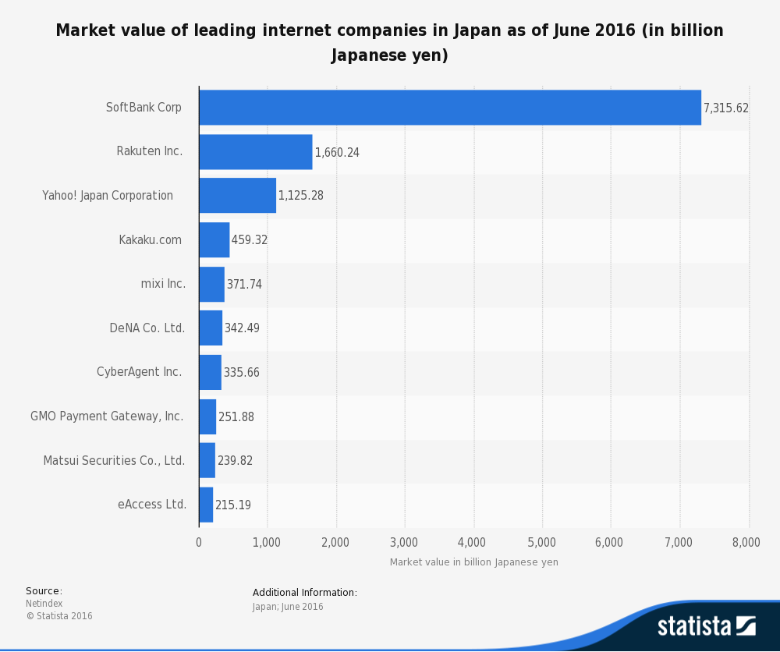

Slide 15
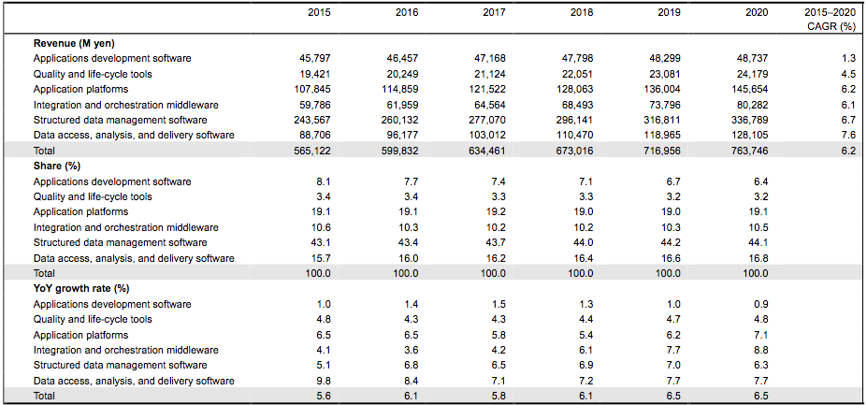
Japan Applications Development and Deployment Market Forecast
Source: IDC Japan, December 2016

Slide 16
2017 Japan Revenue Target & Marketing Contribution
WIP
 | K$
ARR Traget | 10,000
Average Deal Size | 140
Page
16

